Slide 1
The Modern Software Developer
CS146S
Stanford University, Fall 2025
Mihail Eric
themodernsoftware.dev

Slide 2

Guest Lecture - 11/7/25
CPO of Graphite, Tomas Reimers
themodernsoftware.dev
Notes:
Pause for questions

Slide 3
AI Code Review
themodernsoftware.dev

Slide 4
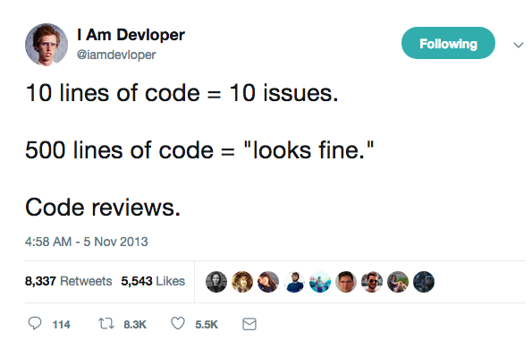
themodernsoftware.dev

Slide 5
Why
Software code review is one of the highest leverage activities you can do to become a better engineer and improve overall team code quality
themodernsoftware.dev

Slide 6
Statistics
Code review has 55-60% error detection rate compared to 25-45% for different testing modes
Study of errors on programs without/with code review reported 4.5 → 0.82 errors/100 lines
Study at AT&T showed code review had 14% increase in productivity and 90% decrease in defects
Source: Coding Horror
themodernsoftware.dev

Slide 7
What to Catch
Logic and correctness errors
themodernsoftware.dev

Slide 8
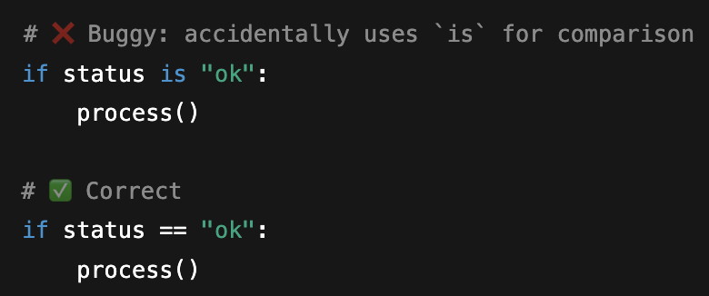
themodernsoftware.dev

Slide 9
What to Catch
Readability and maintainability
themodernsoftware.dev

Slide 10
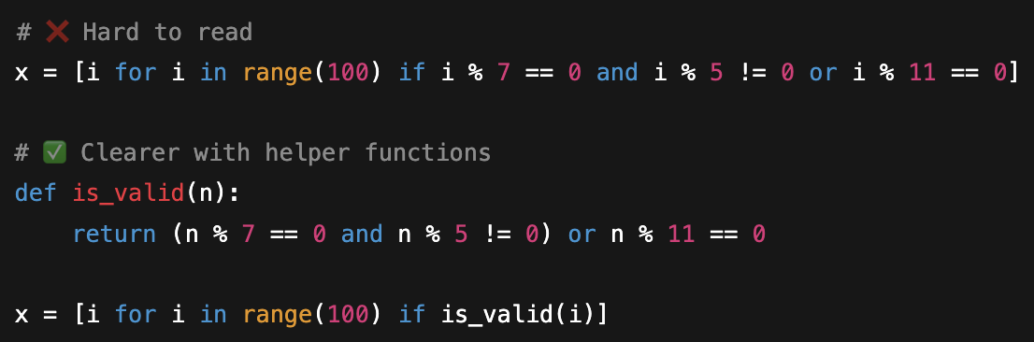
themodernsoftware.dev

Slide 11
What to Catch
Performance
themodernsoftware.dev

Slide 12
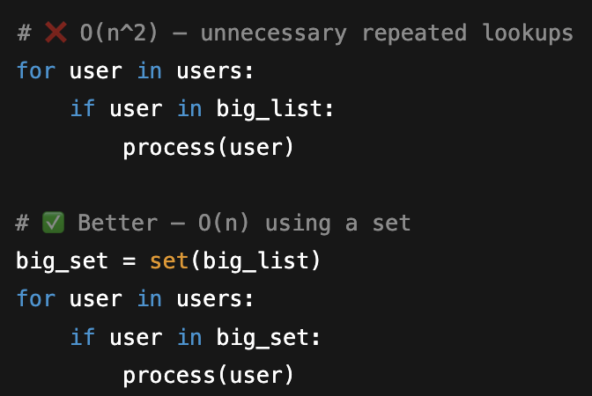
themodernsoftware.dev

Slide 13
What to Catch
Security
themodernsoftware.dev

Slide 14
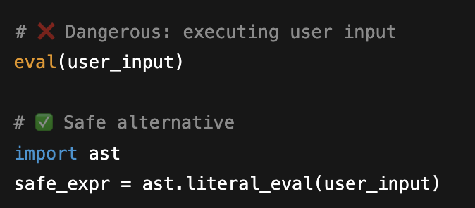
themodernsoftware.dev

Slide 15
What to Catch
Best practices
themodernsoftware.dev

Slide 16
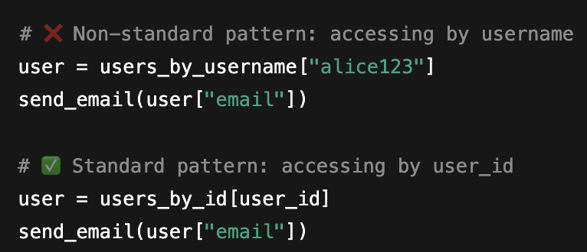
themodernsoftware.dev
Notes:
Idioms in your codebase
Database access patterns (i.e. use this service rather than a direct DB lookup)

Slide 17
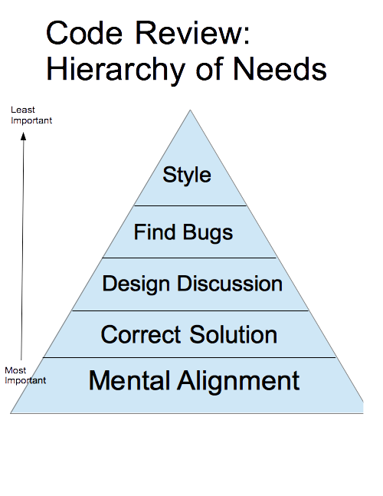
Source: Blake Smith
themodernsoftware.dev
Notes:
Helps team members adapt their mental model of the system as it’s changing
Ensures the change correctly solves the problem
Opens discussion for strengths and weaknesses of a design
Catches bugs before they get to production
Keeps the code style and organization consistent

Slide 18
What’s a Good Code Review
This won’t work
vs
I see your new method matches the existing style in this file, taking [X] parameters. Having that many parameters hurts readability and implies the function is doing too much. What do you think about refactoring this method and the existing ones in a later pull request to reduce how many parameters they take?
themodernsoftware.dev
Notes:
Provides specific details.
References specific code or issues.
Suggests a resolution to the problem.
Cites evidence or provides an explanation

Slide 19
The New AI World
Graphite (guest lecture 11/7)
Greptile
Coderabbit
Claude Code / Codex
themodernsoftware.dev

Slide 20
What Has Changed
Efficiency
Consistency
Knowledge sharing
Reduced cognitive load
Continuous improvement
Holistic understanding of your code
themodernsoftware.dev
Notes:
Automation reduces review time and catches issues early
Developers learn best practices through AI suggestions
AI applies the same standards across all code reviews
AI handles routine checks, letting humans focus on complex logic
AI systems improve over time with more data
modern AI code review tools go deeper, offering contextual analysis and pattern recognition

Slide 21
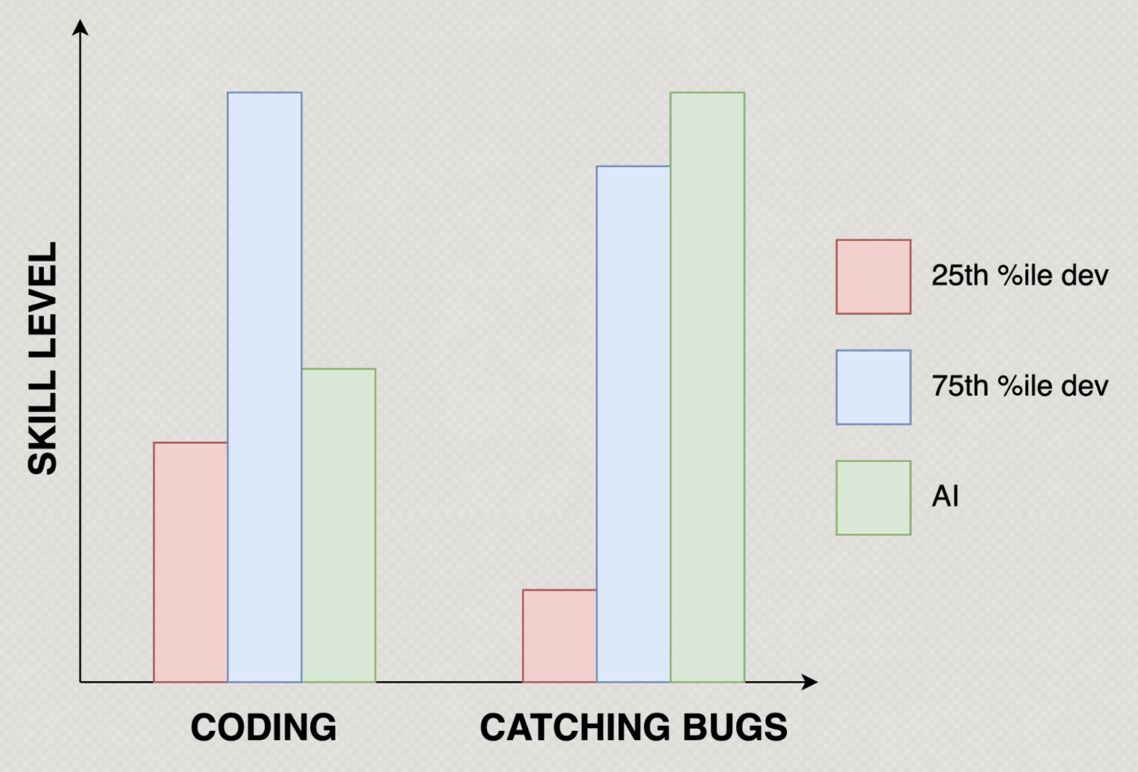
Source: Greptile
themodernsoftware.dev
Notes:
Automation reduces review time and catches issues early
Developers learn best practices through AI suggestions
AI applies the same standards across all code reviews
AI handles routine checks, letting humans focus on complex logic
AI systems improve over time with more data
modern AI code review tools go deeper, offering contextual analysis and pattern recognition

Slide 22
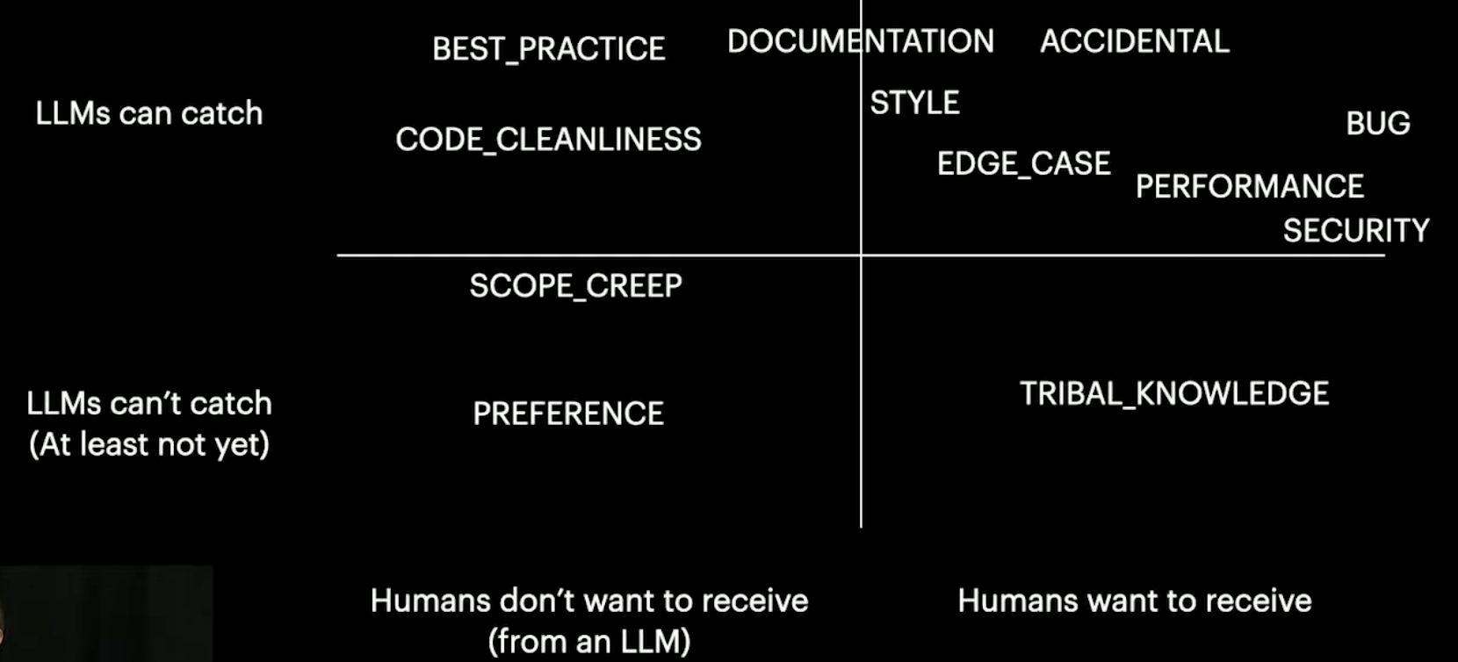
Source: Graphite
themodernsoftware.dev
Notes:
Source: https://www.youtube.com/watch?v=TswQeKftnaw

Slide 23
Let’s See AI Code Review in Action
themodernsoftware.dev
Notes:
Graphite example
Developers learn best practices through AI suggestions
AI applies the same standards across all code reviews
AI handles routine checks, letting humans focus on complex logic
AI systems improve over time with more data
modern AI code review tools go deeper, offering contextual analysis and pattern recognition

Slide 24
Limitations
More configuration/setup
False positives
Have to train the system → continuous learning
Can’t yet catch the idioms and repo best practices
Can’t handle complex business logic and architecture decisions
But that’s where humans are still needed
Must be extra cautious with security changes
Often misses edge cases
Code review is more important now than ever with AI coding systems
You own the code that is merged and shipped, no blaming of the AI
themodernsoftware.dev
Notes:
Need to explicitly tell it what not to review and aspects of your code patterns/idioms
Be especially mindful of user input, authentication, file operations, network requests

Slide 25
Questions?
themodernsoftware.dev

